Slide 1
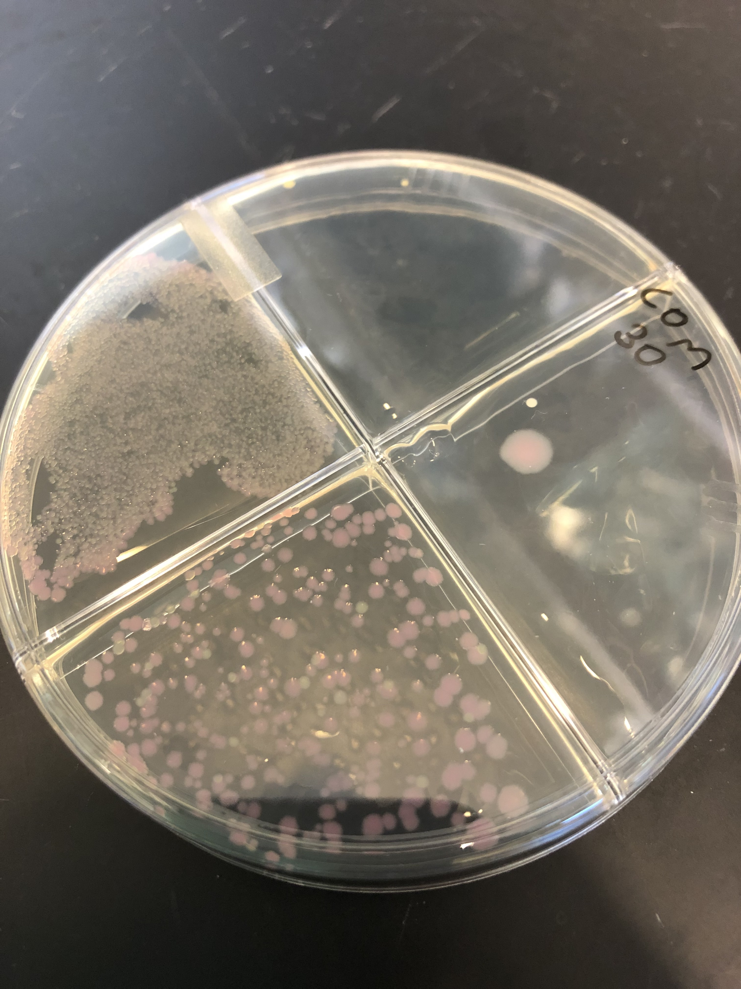
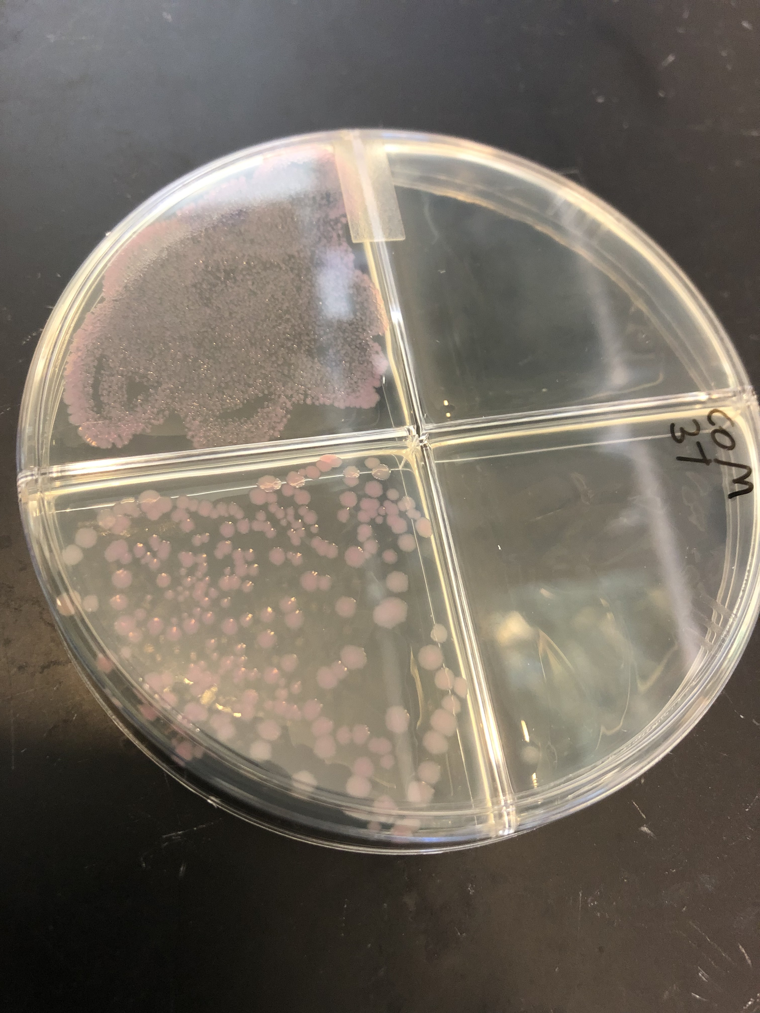
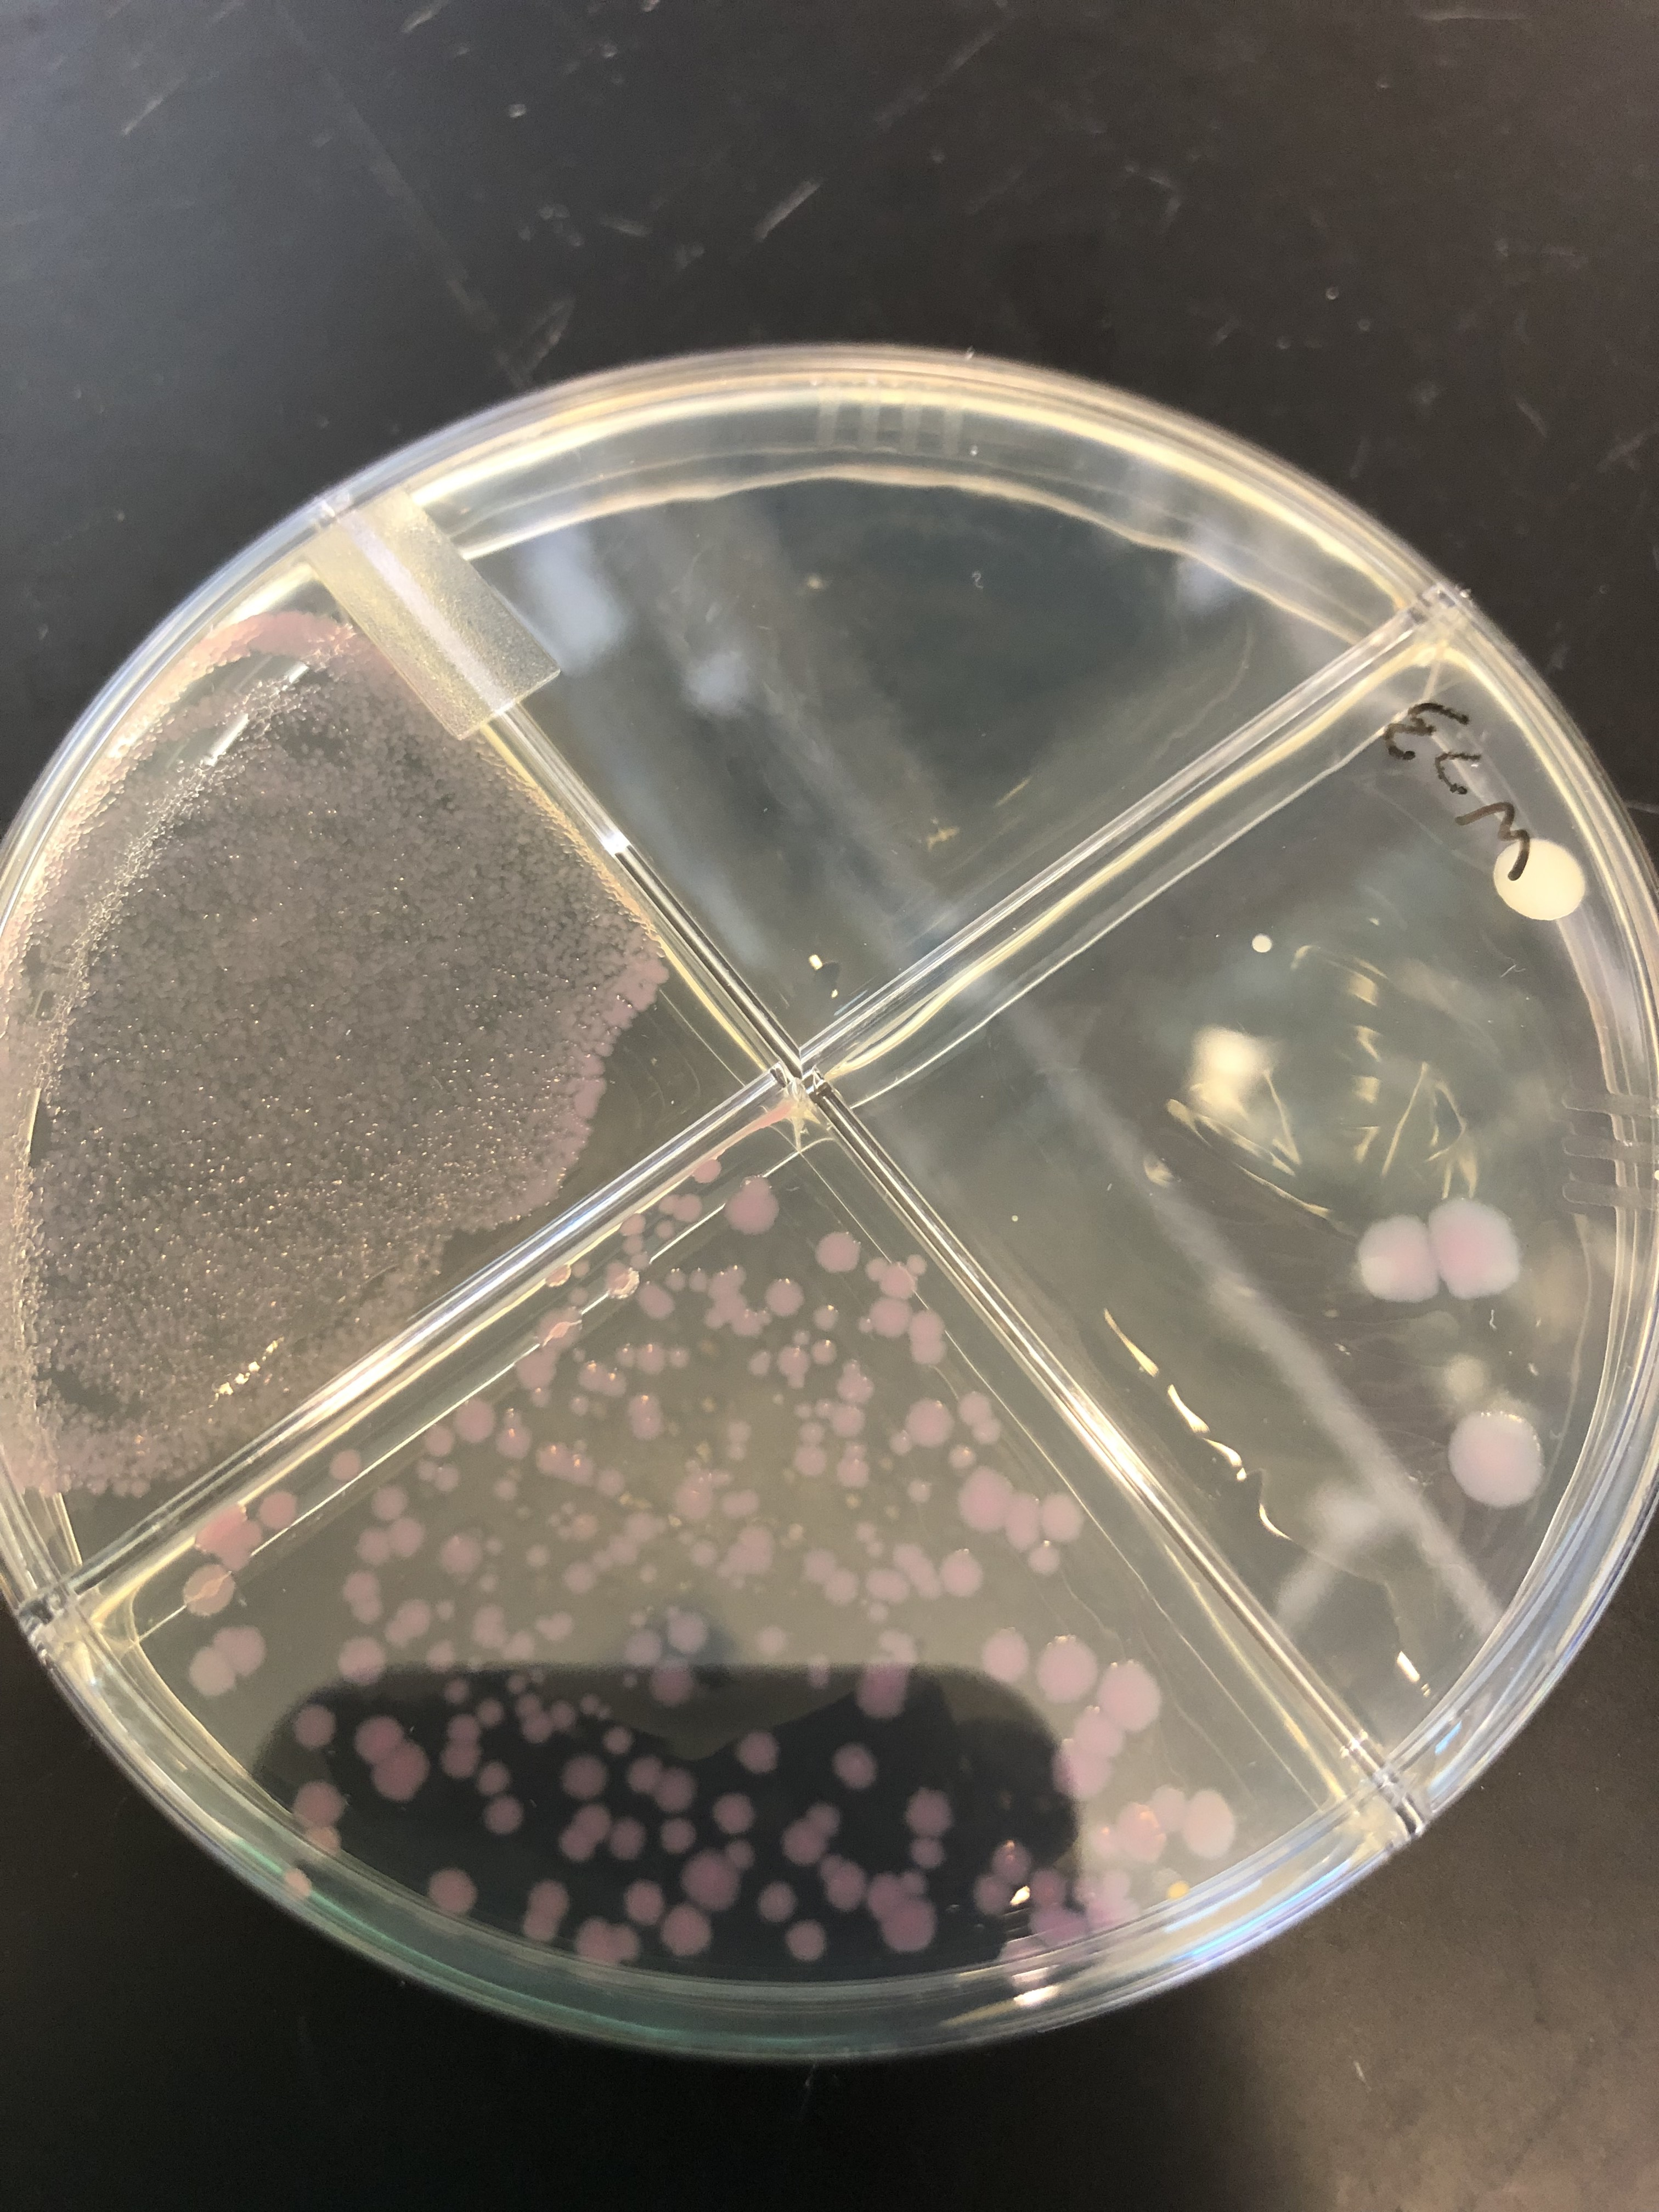
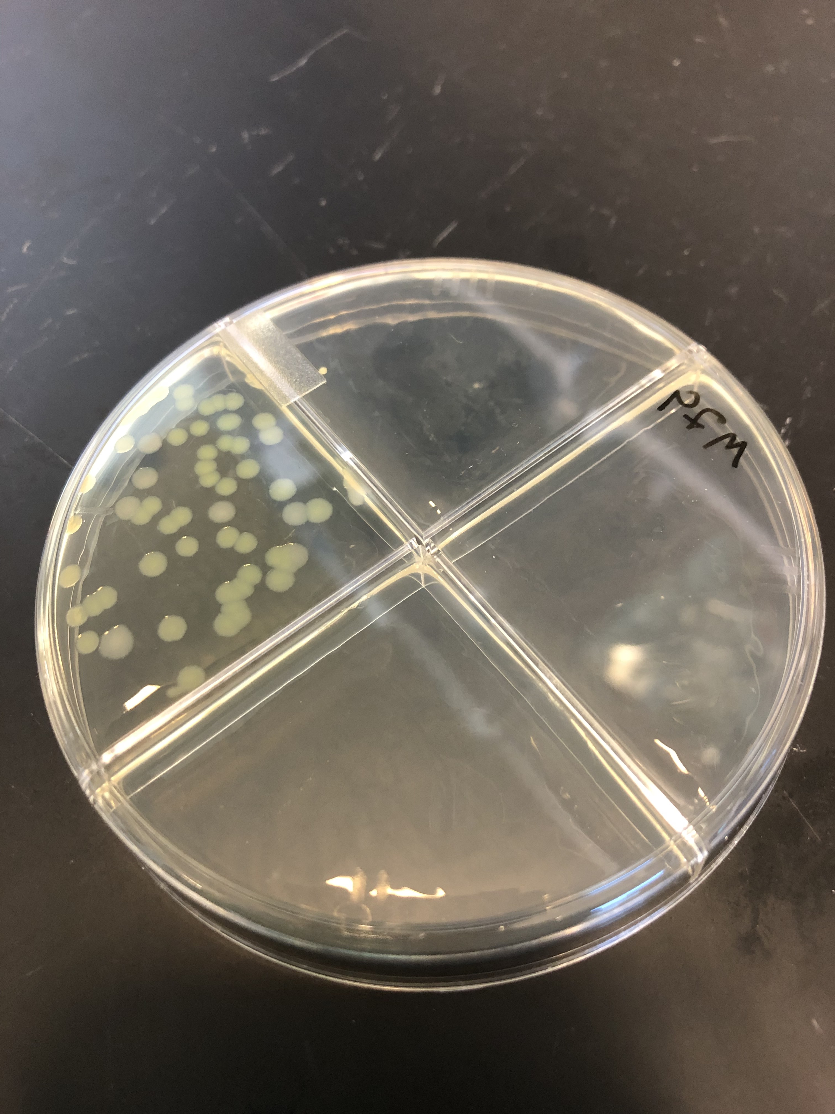
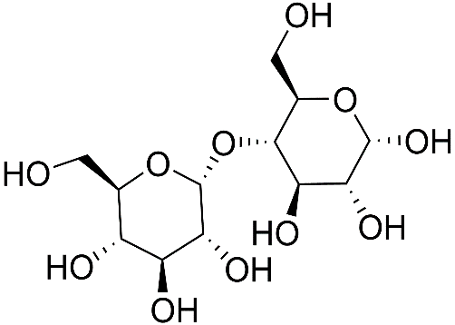
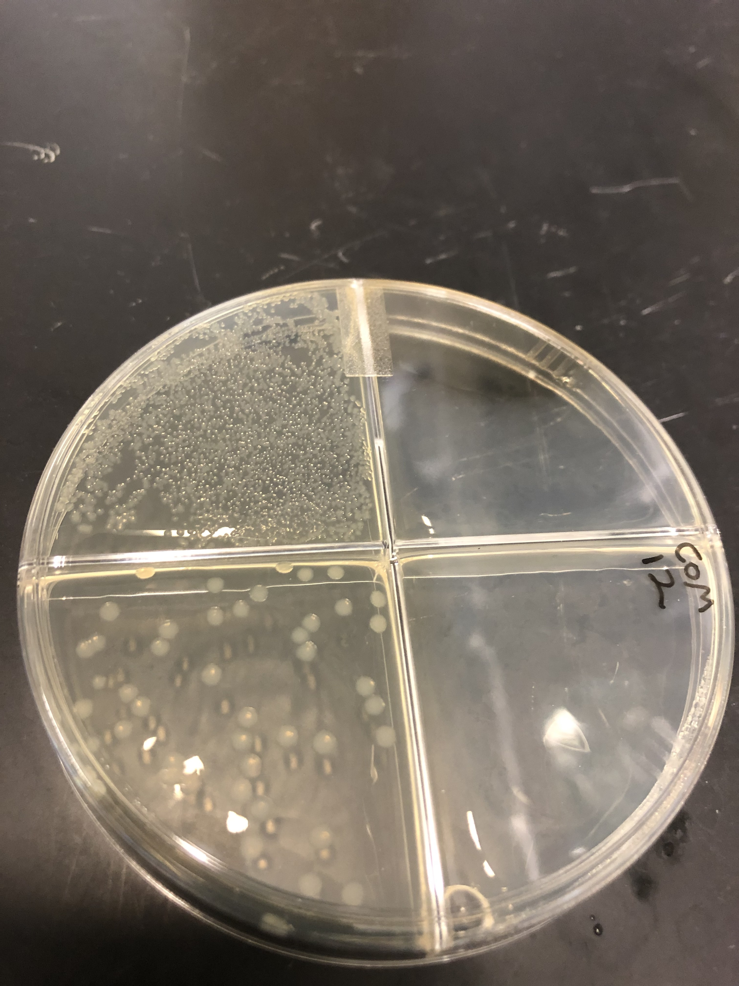
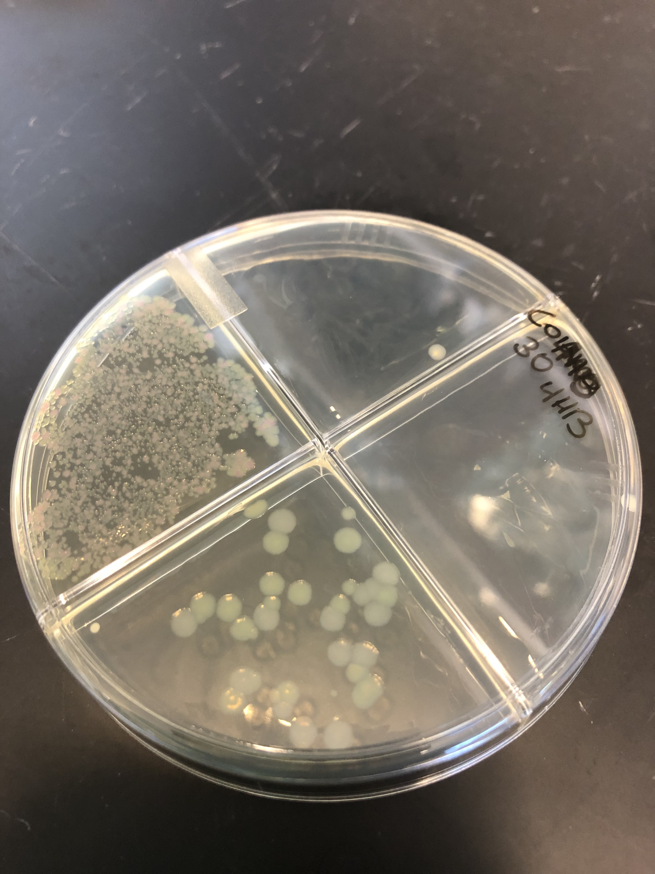
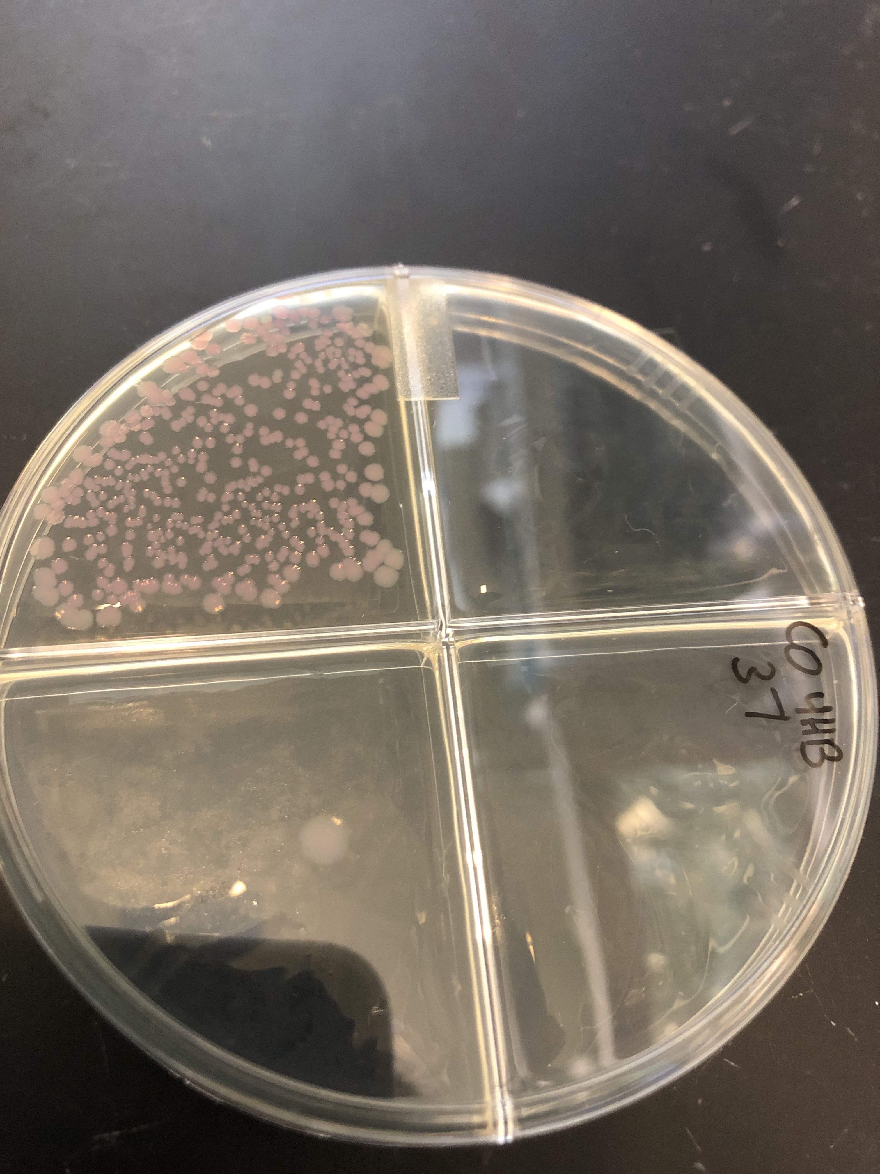
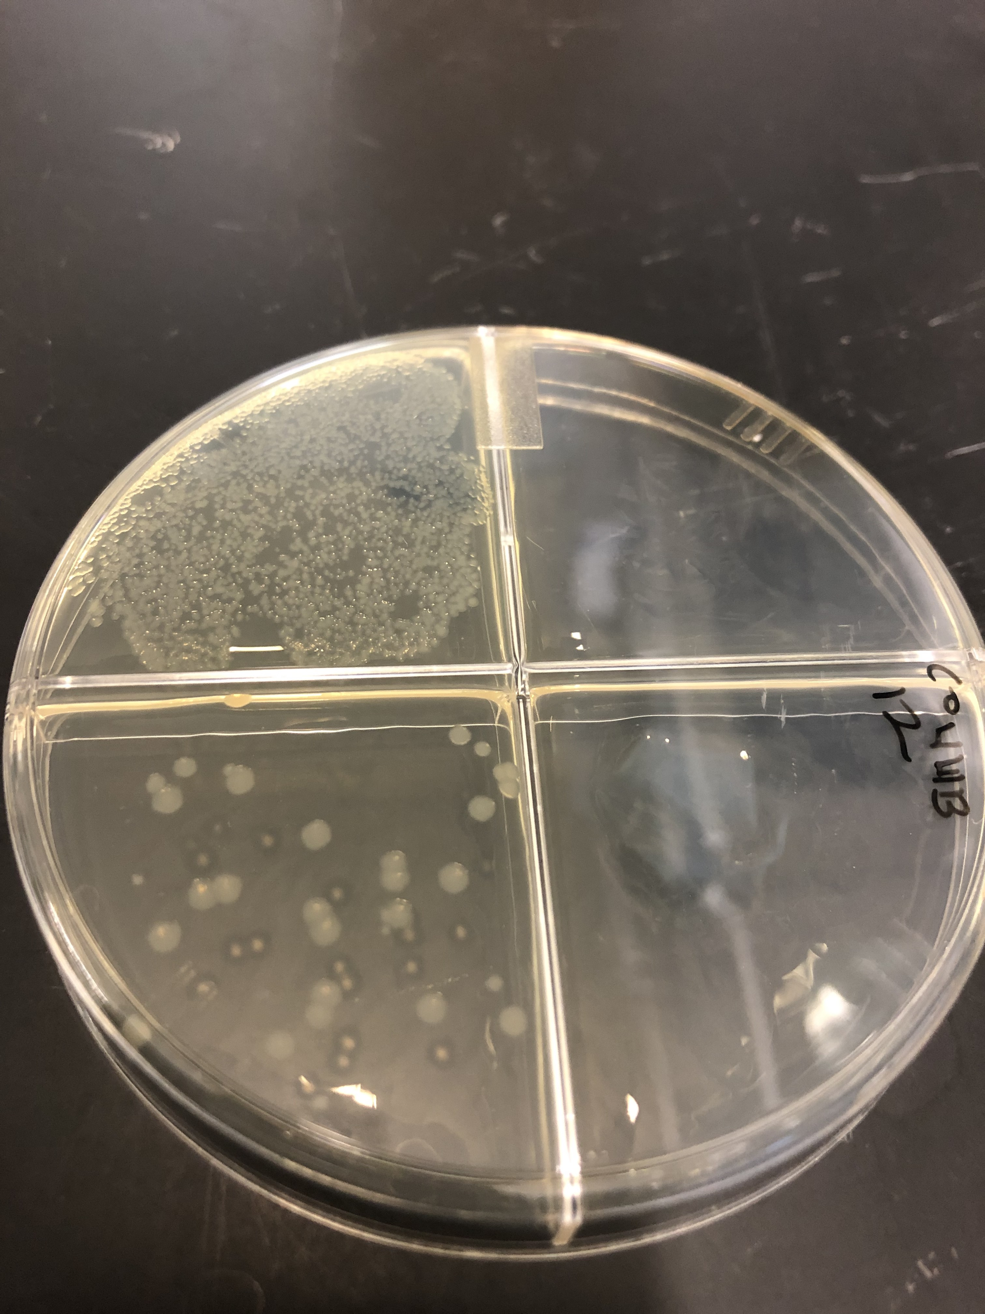
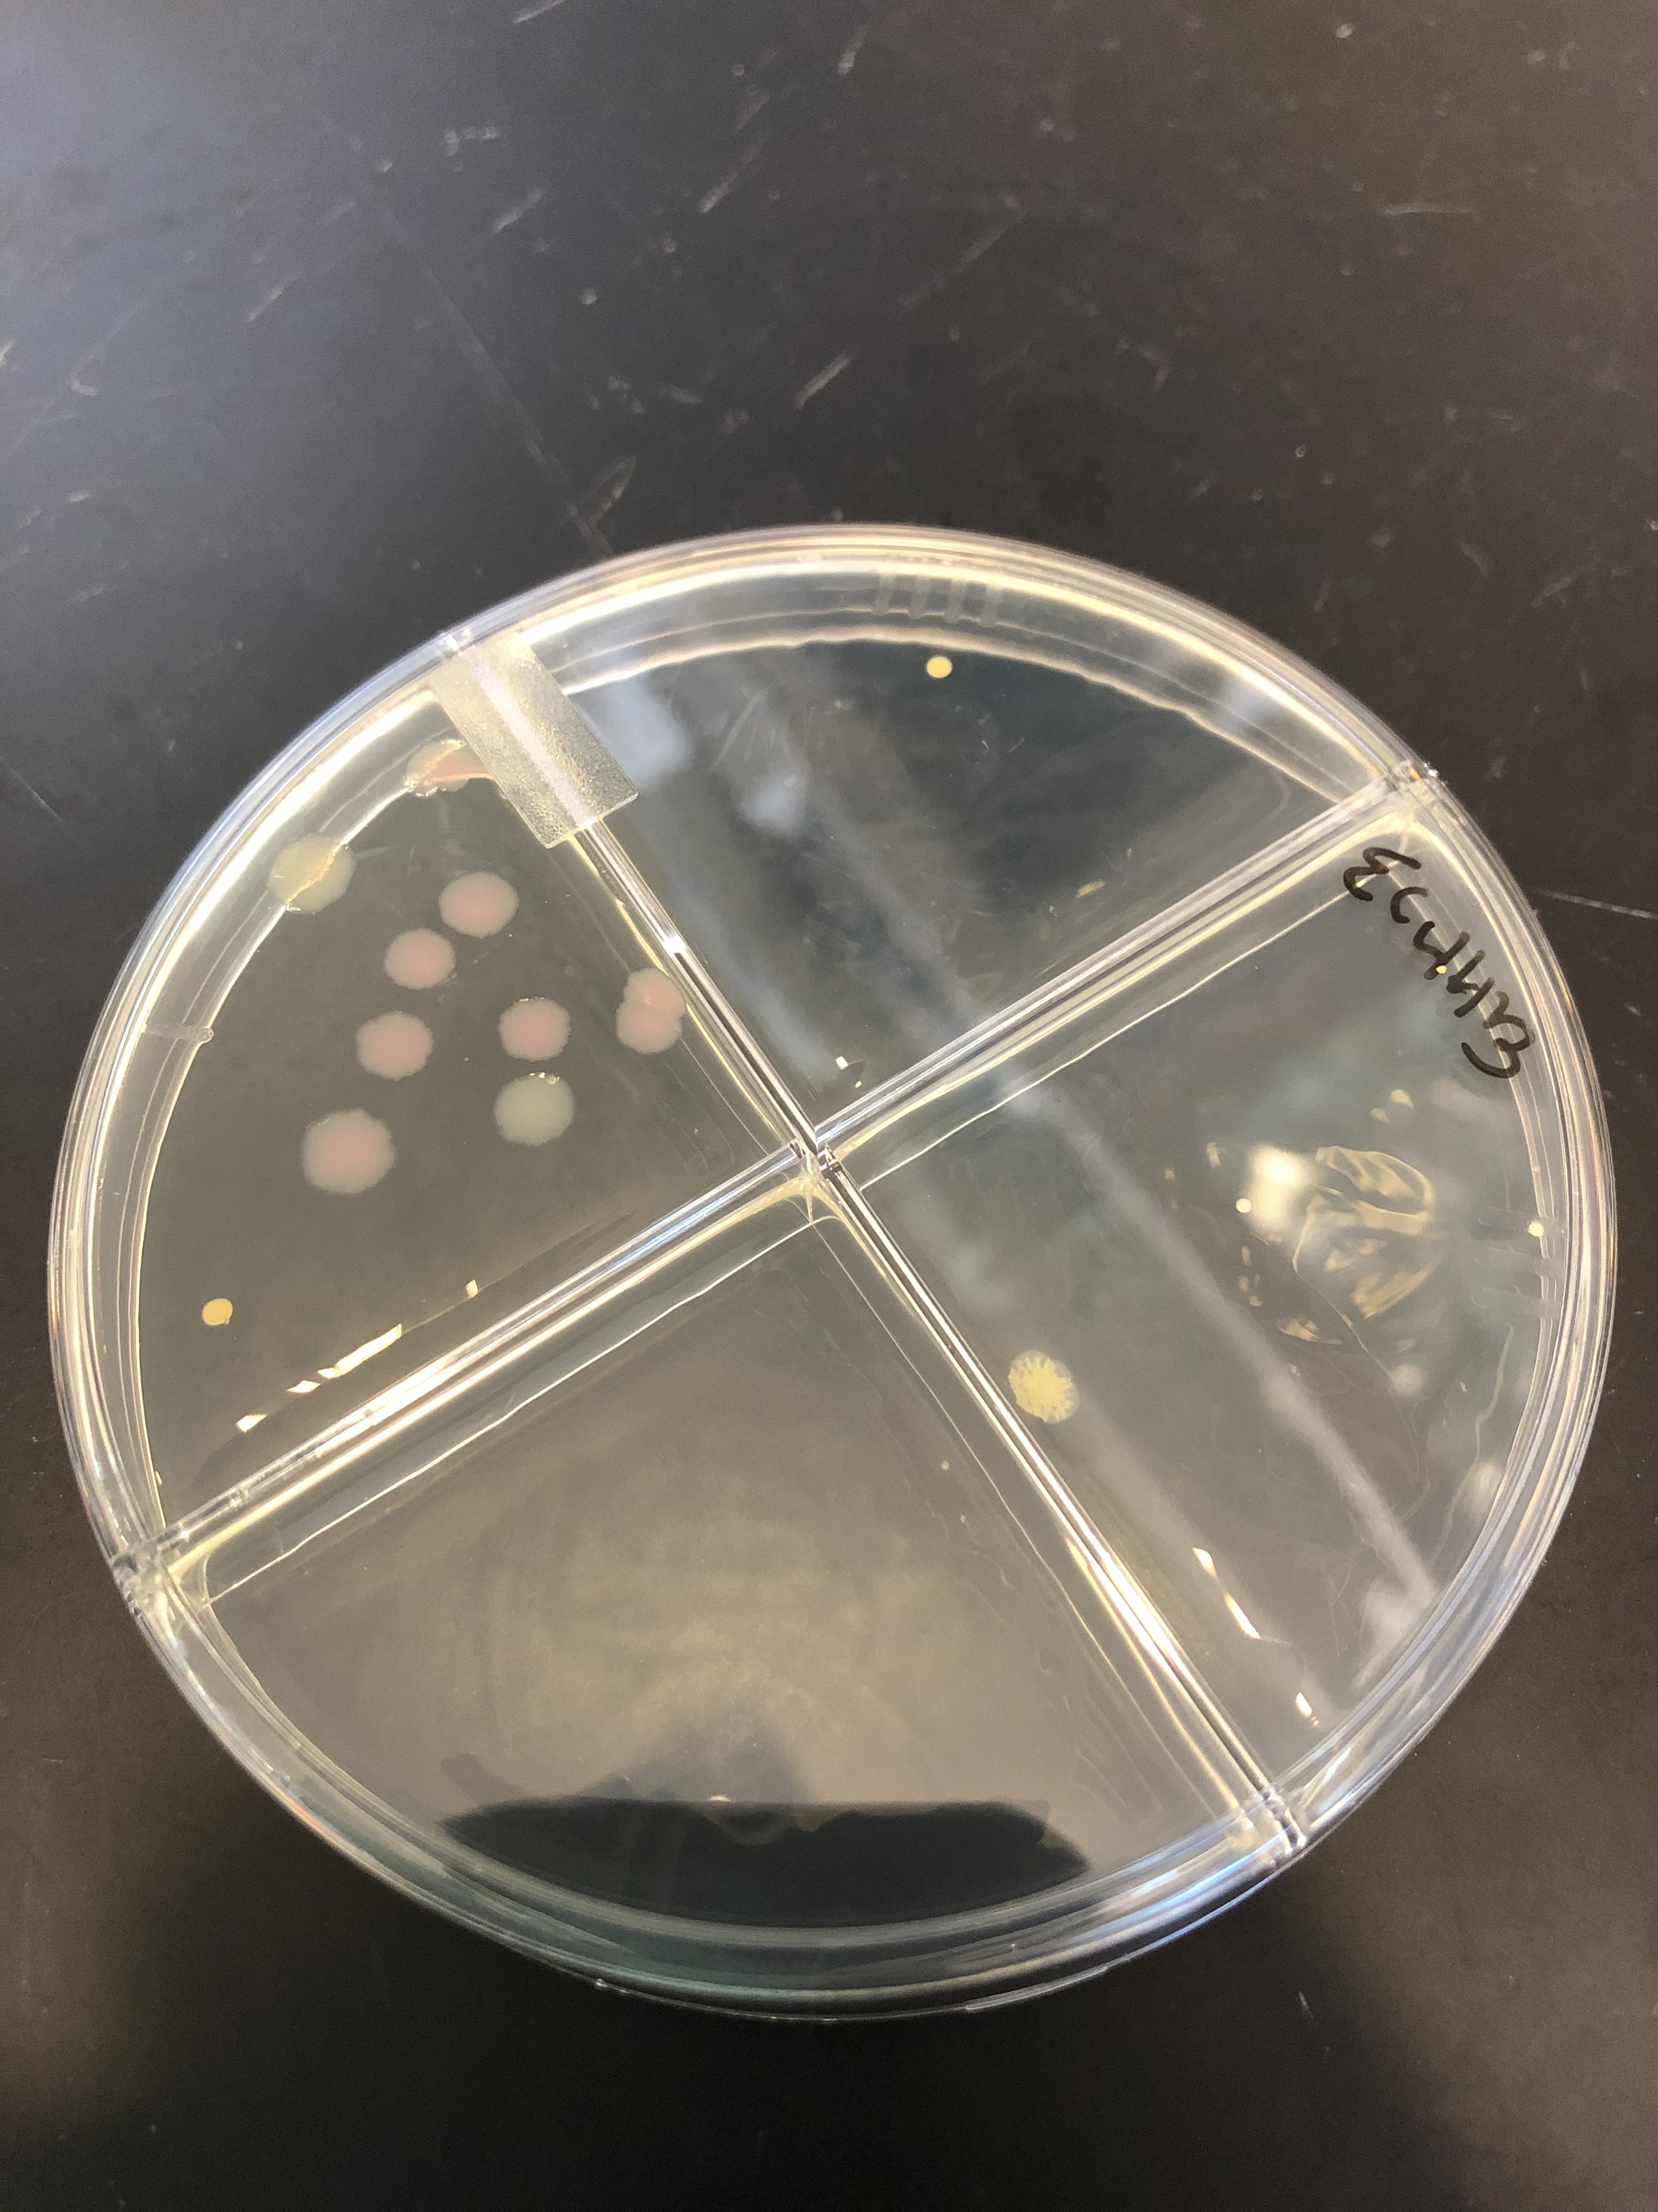
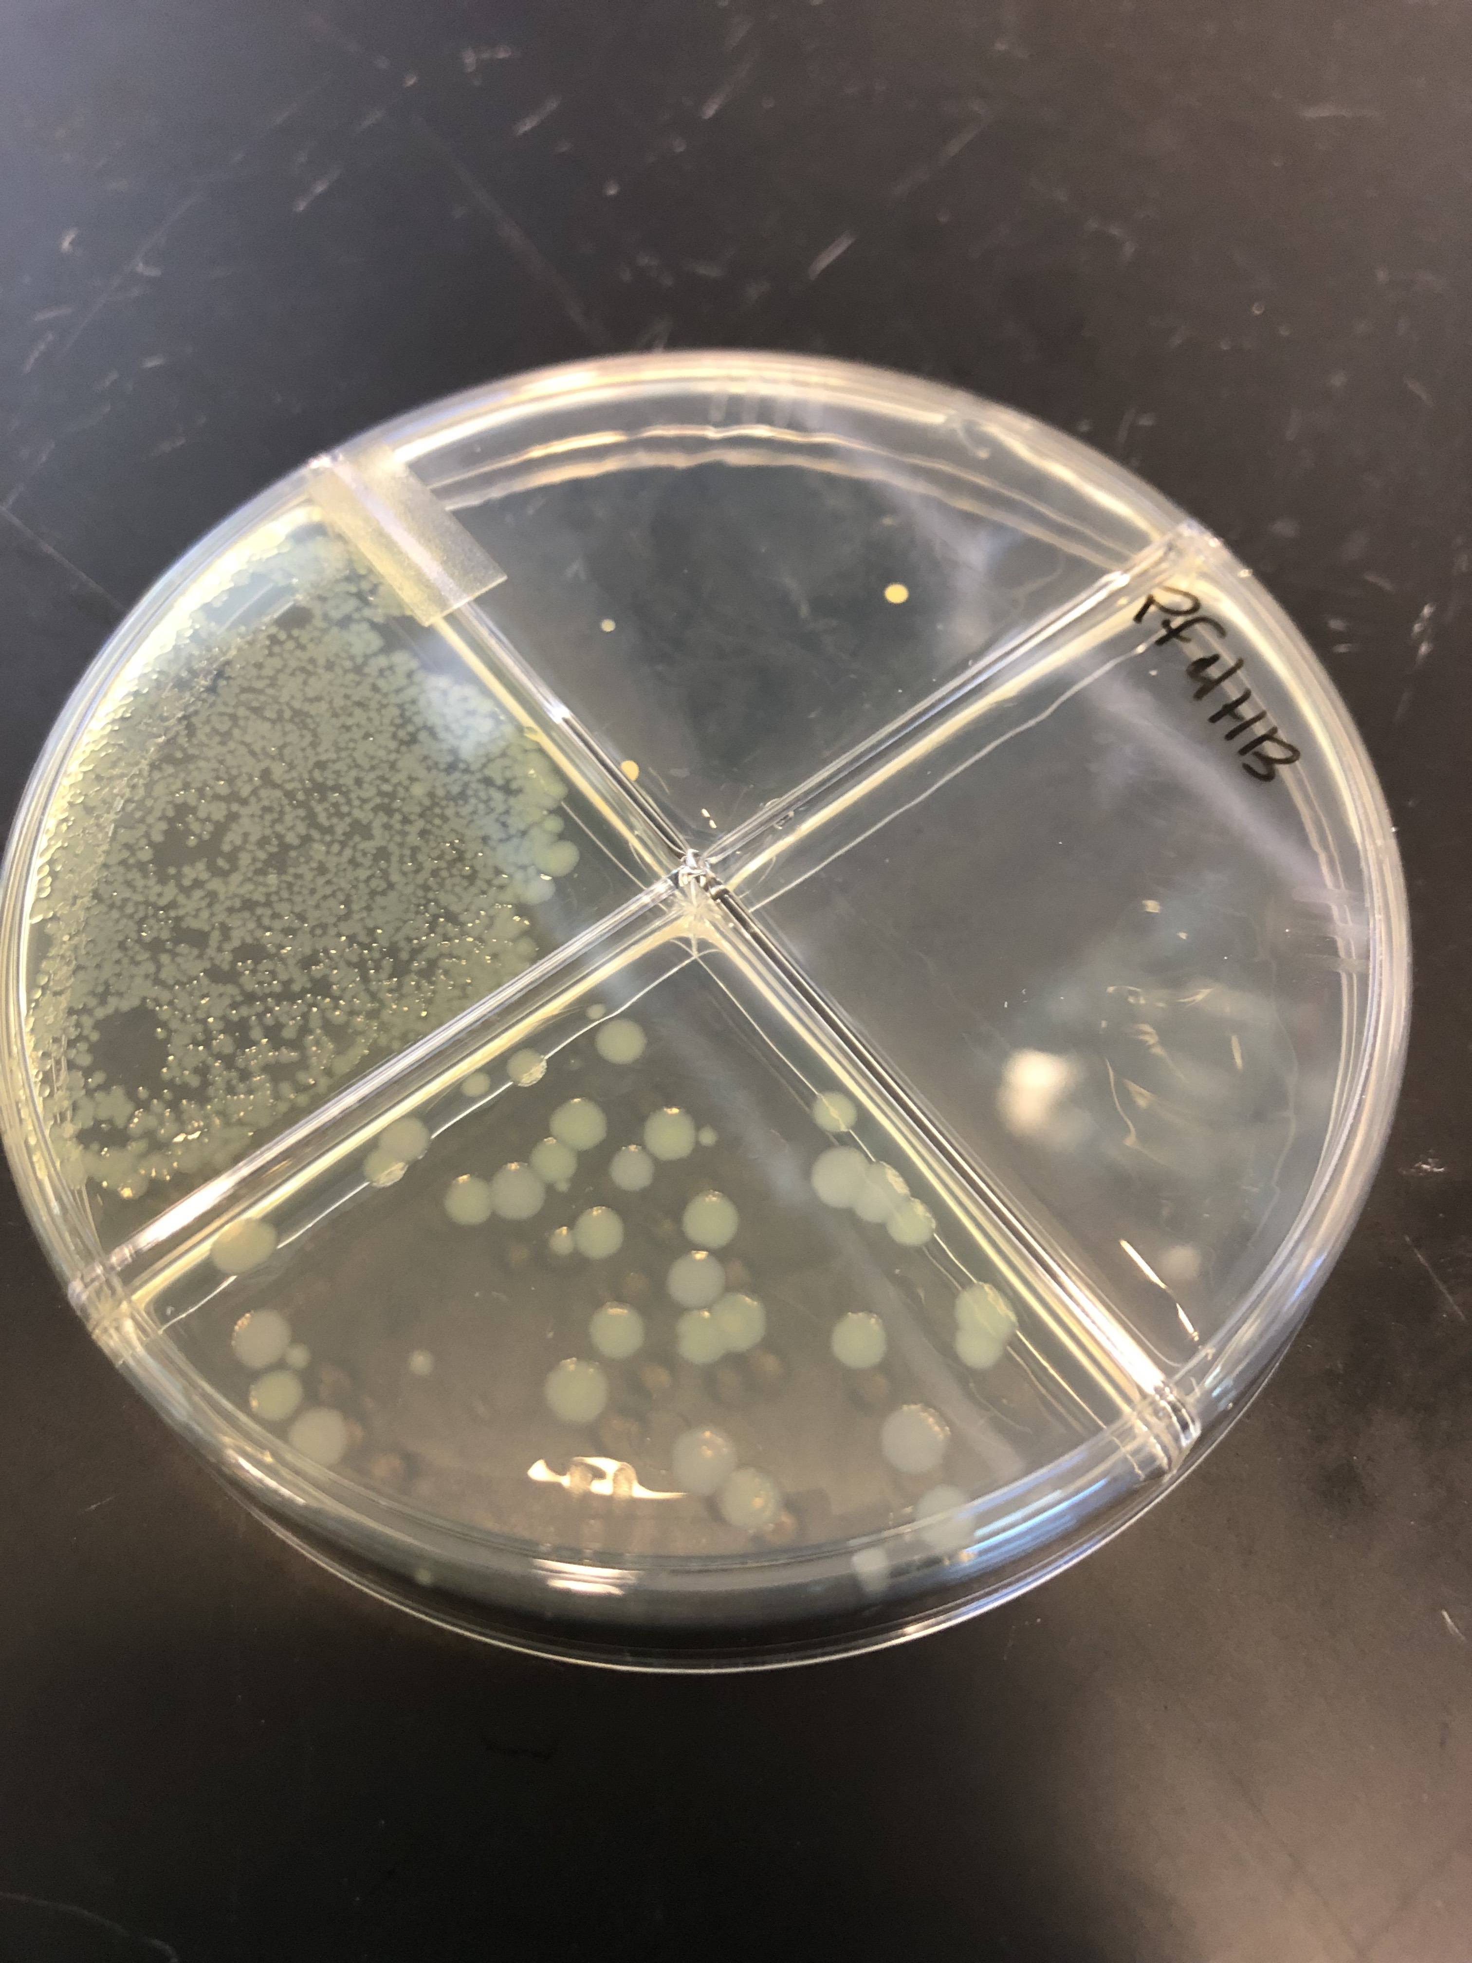
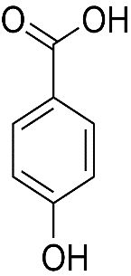
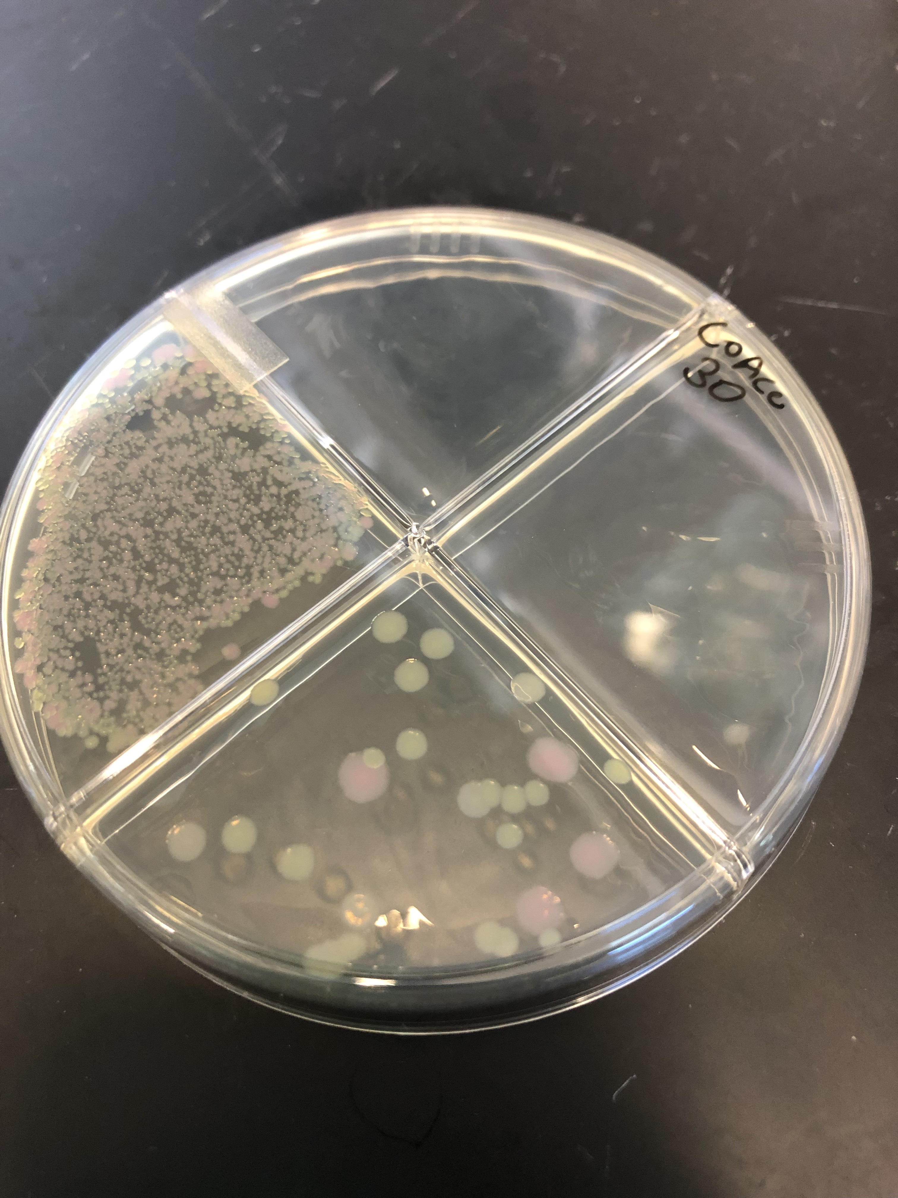
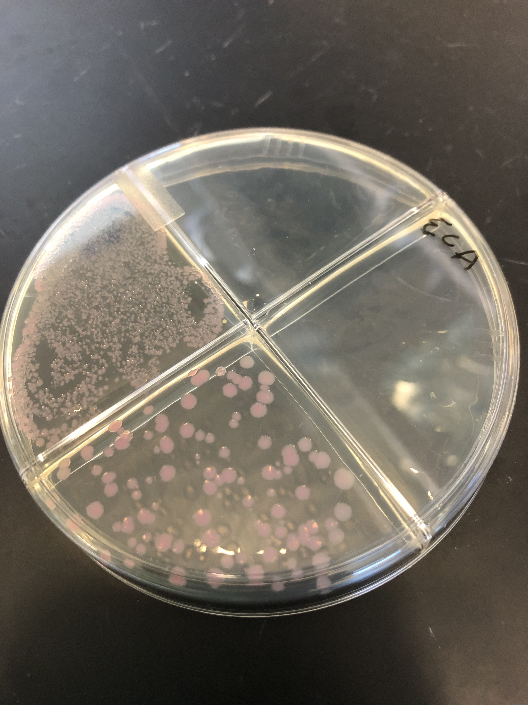
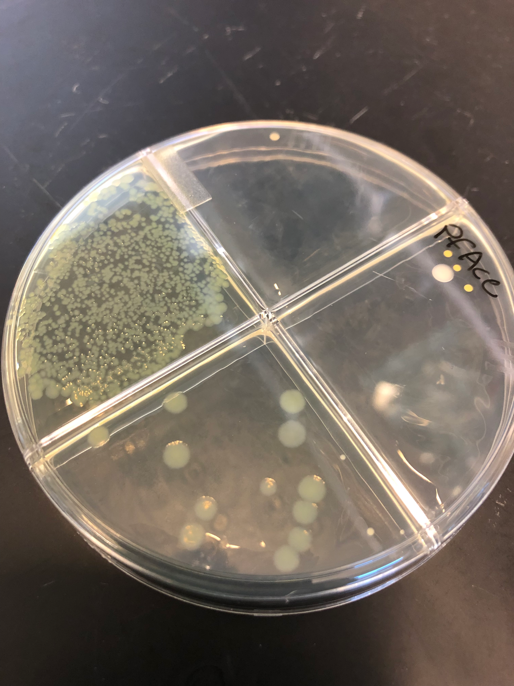
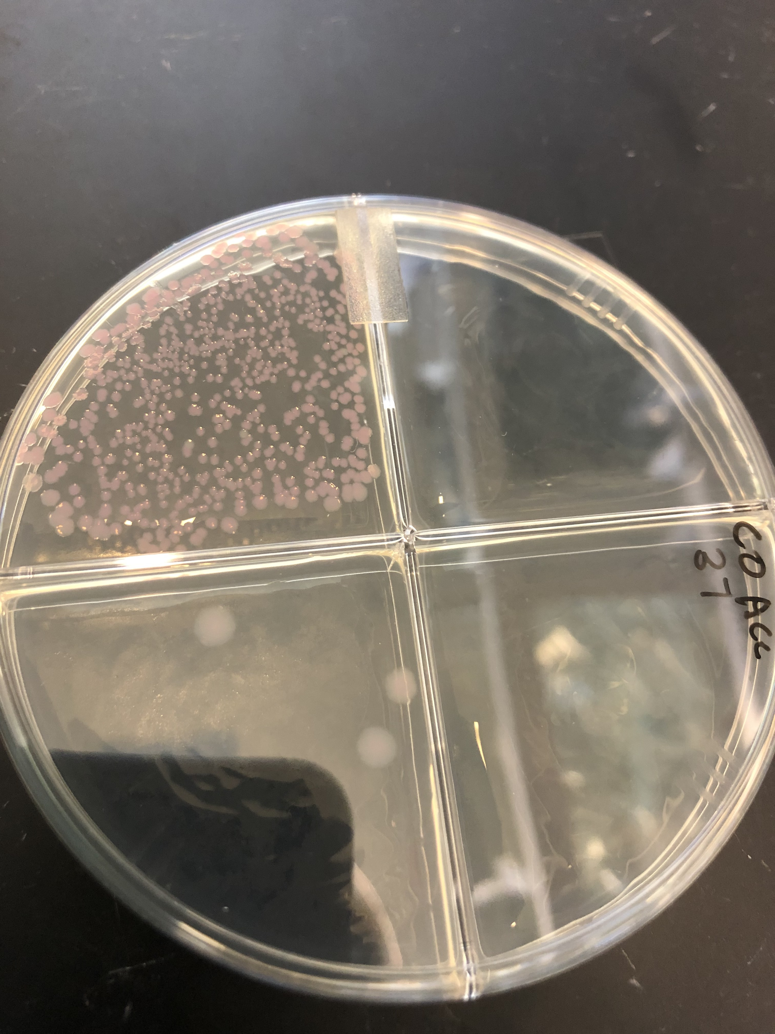
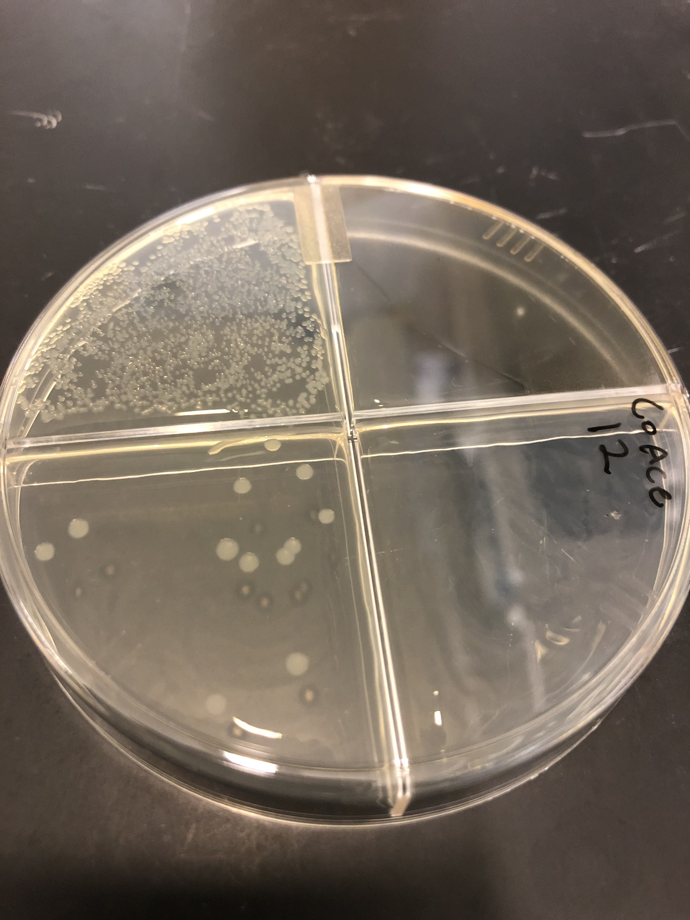
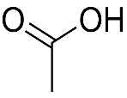
30º plating
Coculture
Monoculture
37º plating
12º plating
E. Coli
P. fluorescens
D-Maltose
4HB
Acetate

Slide 2
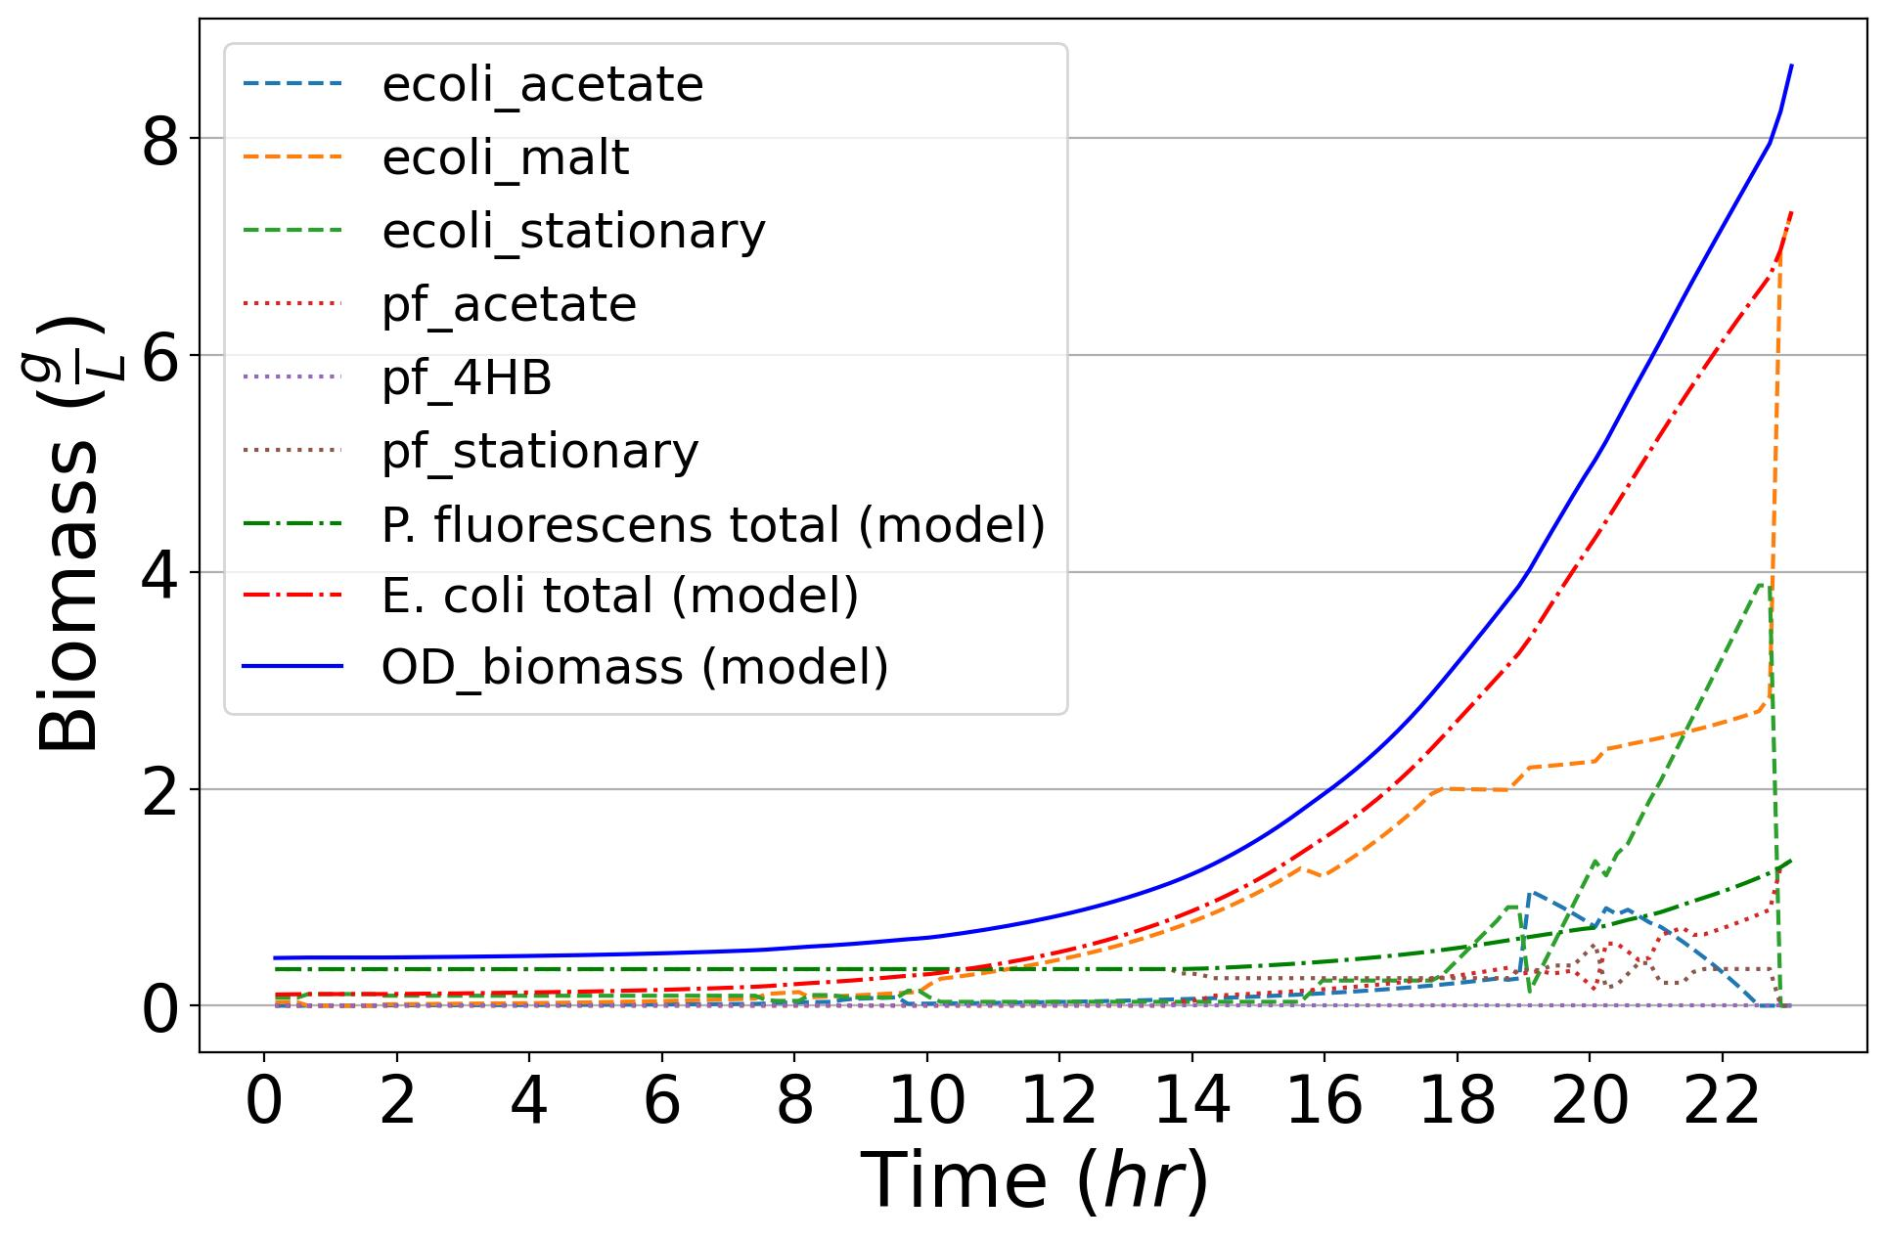
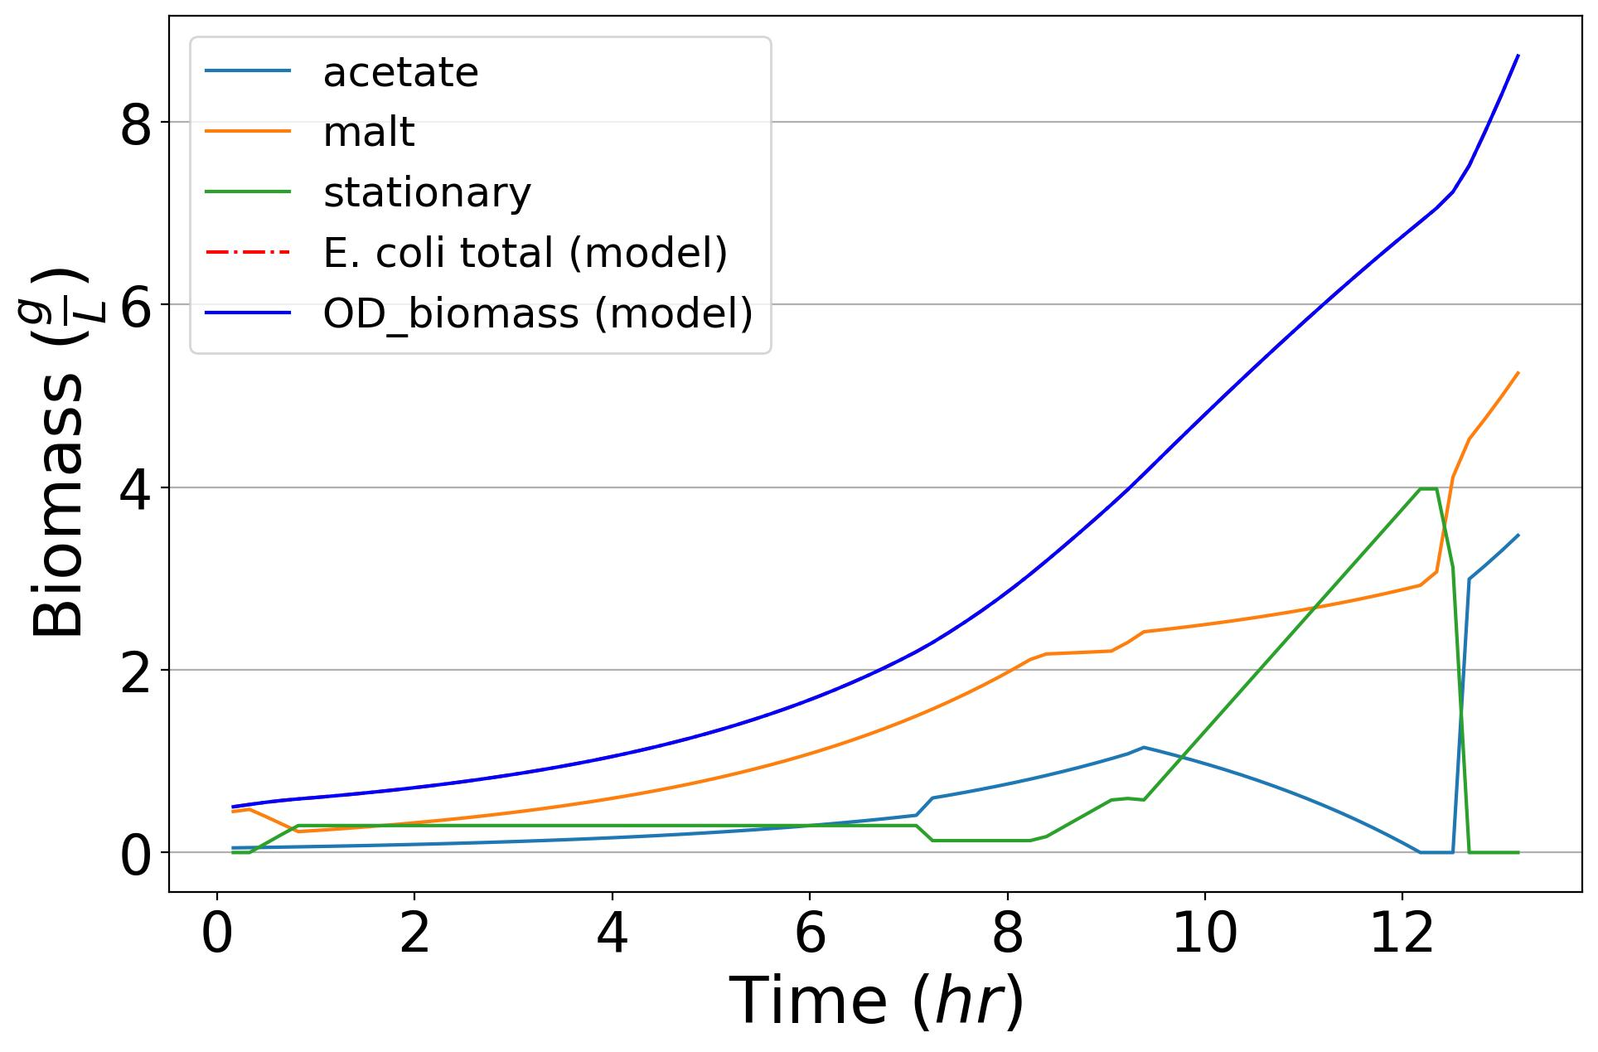
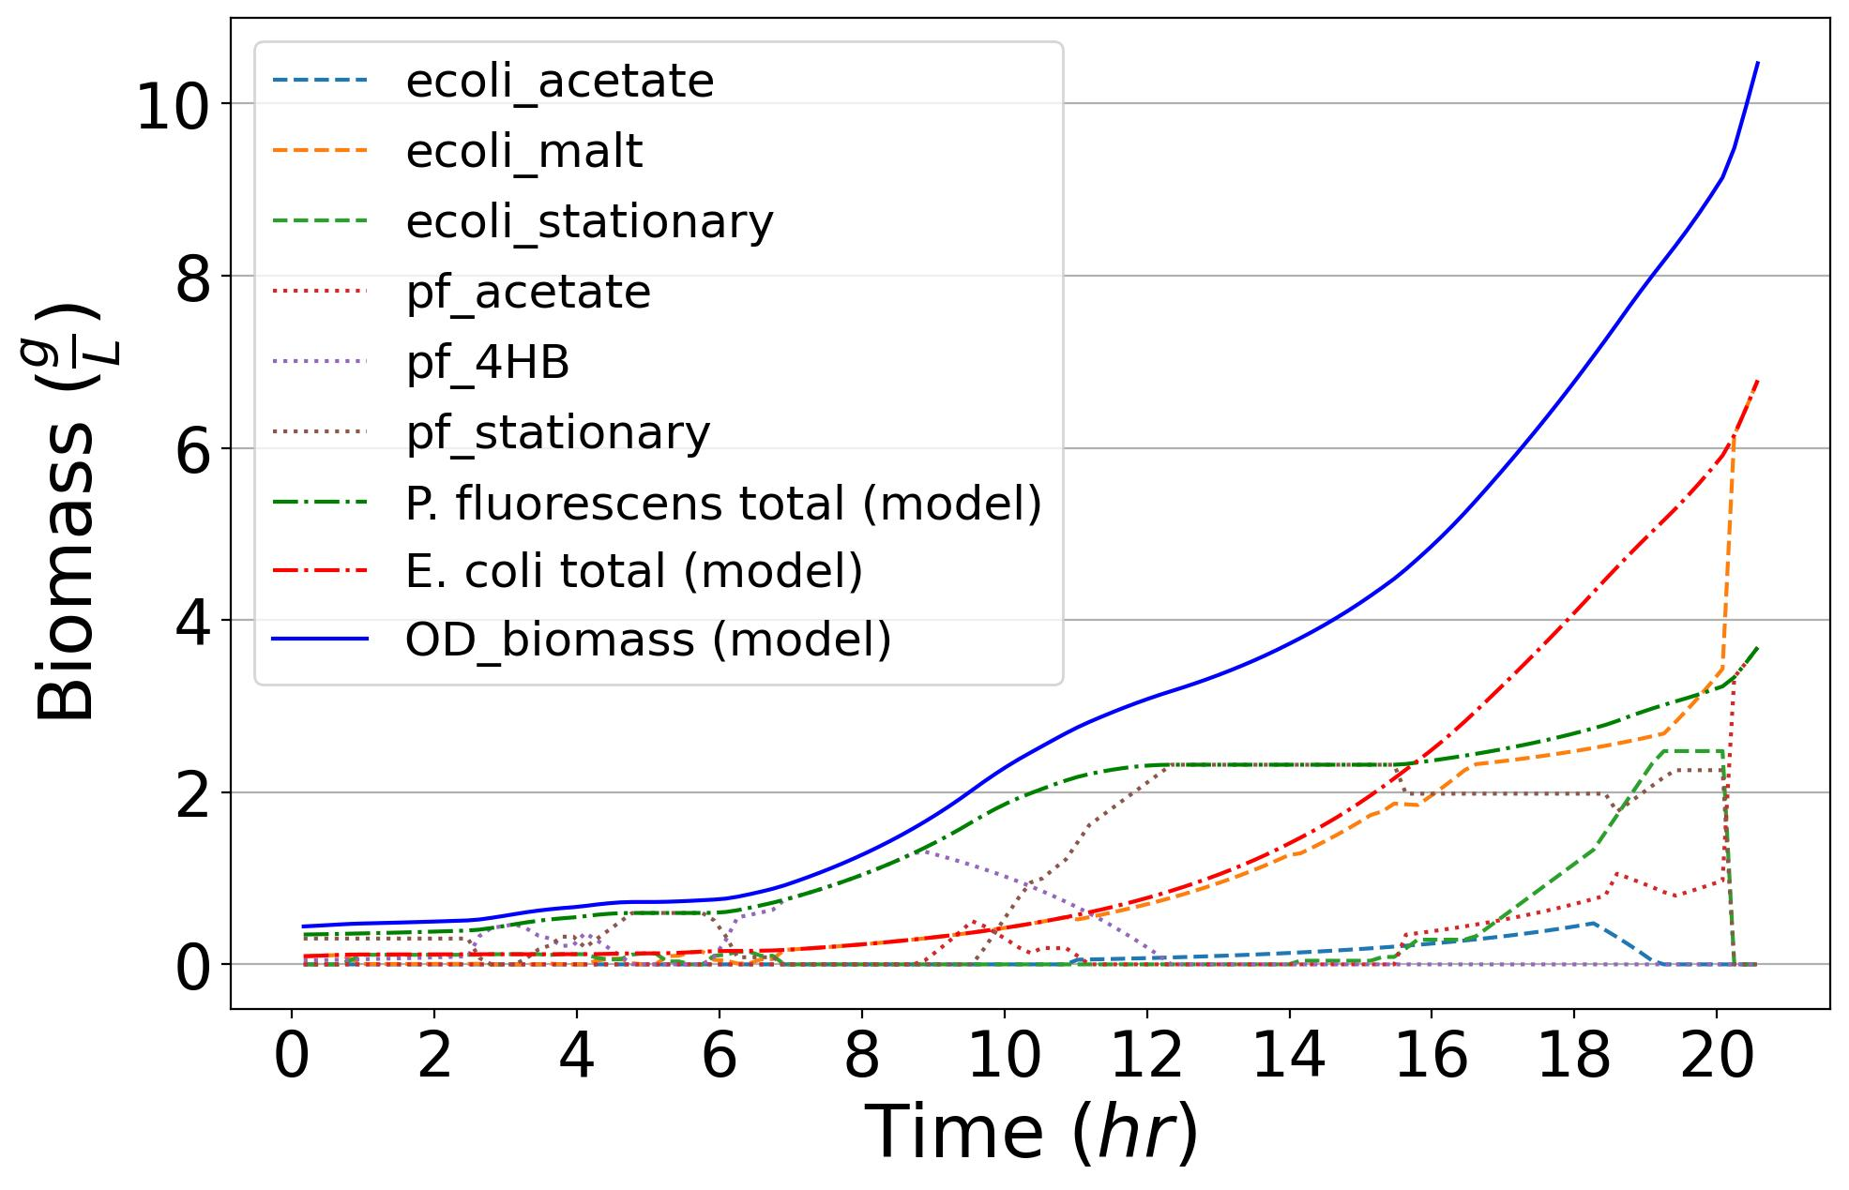
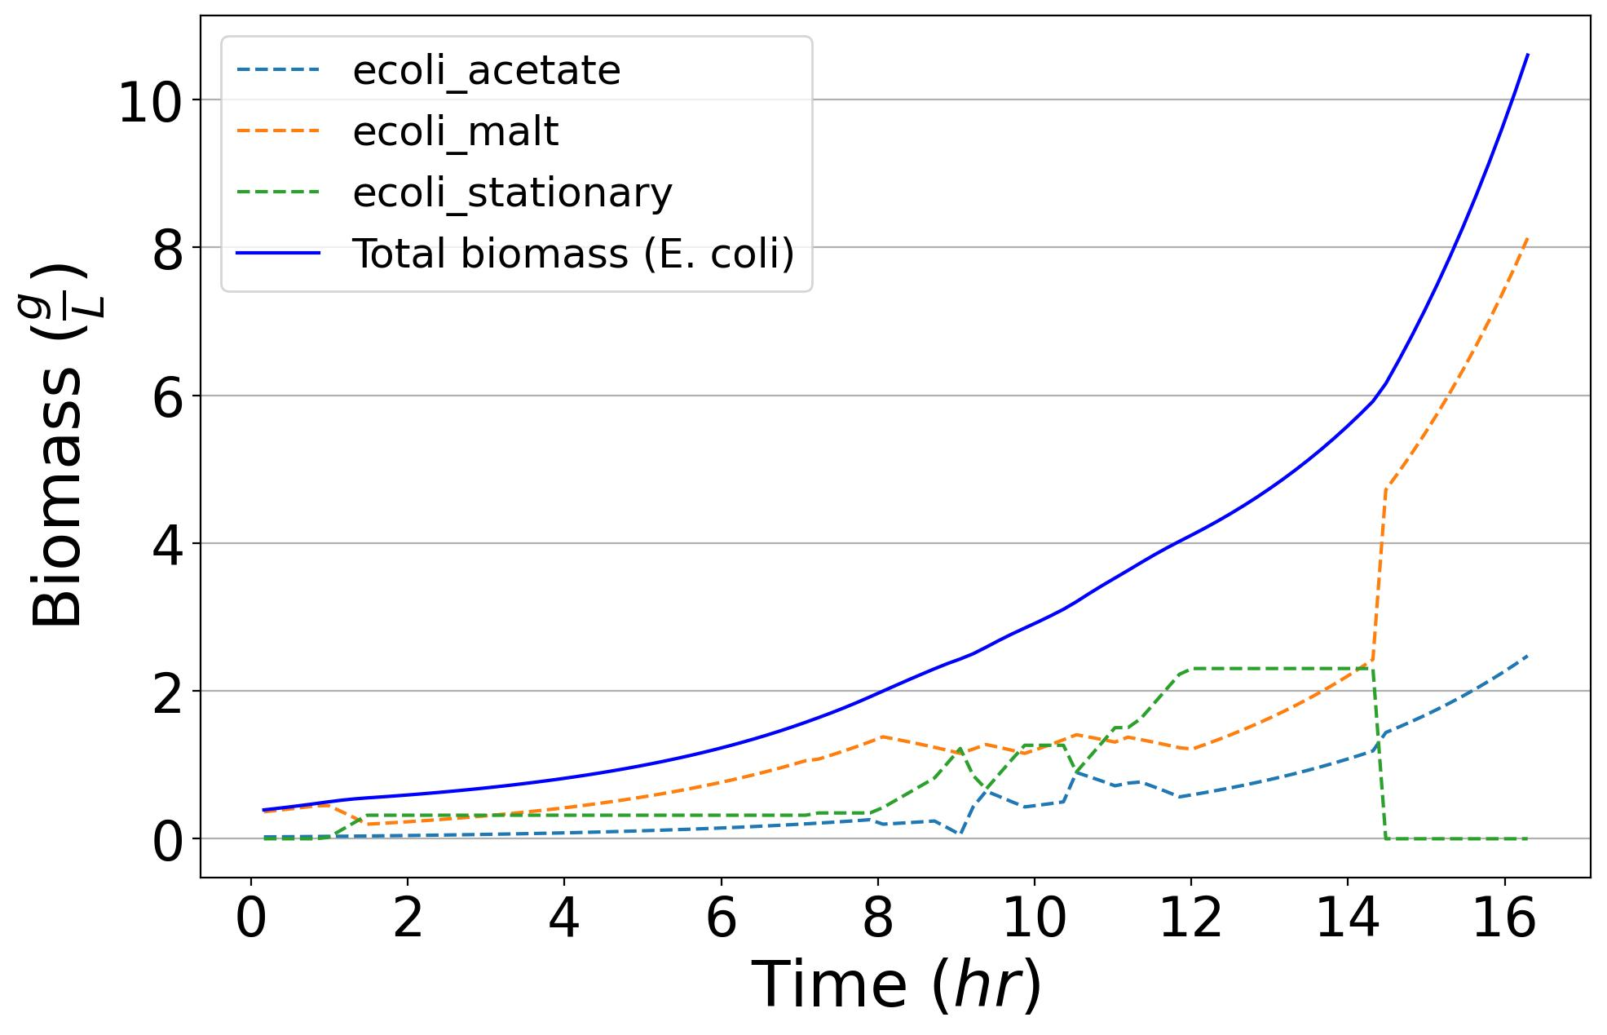
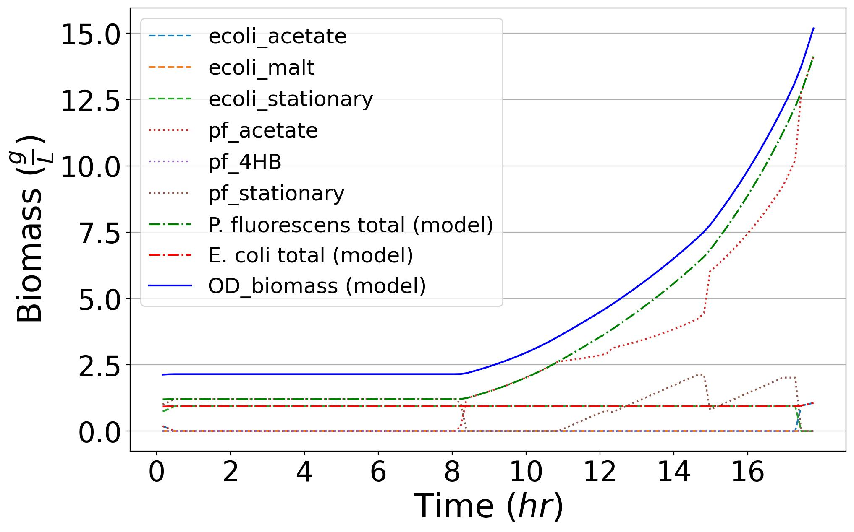
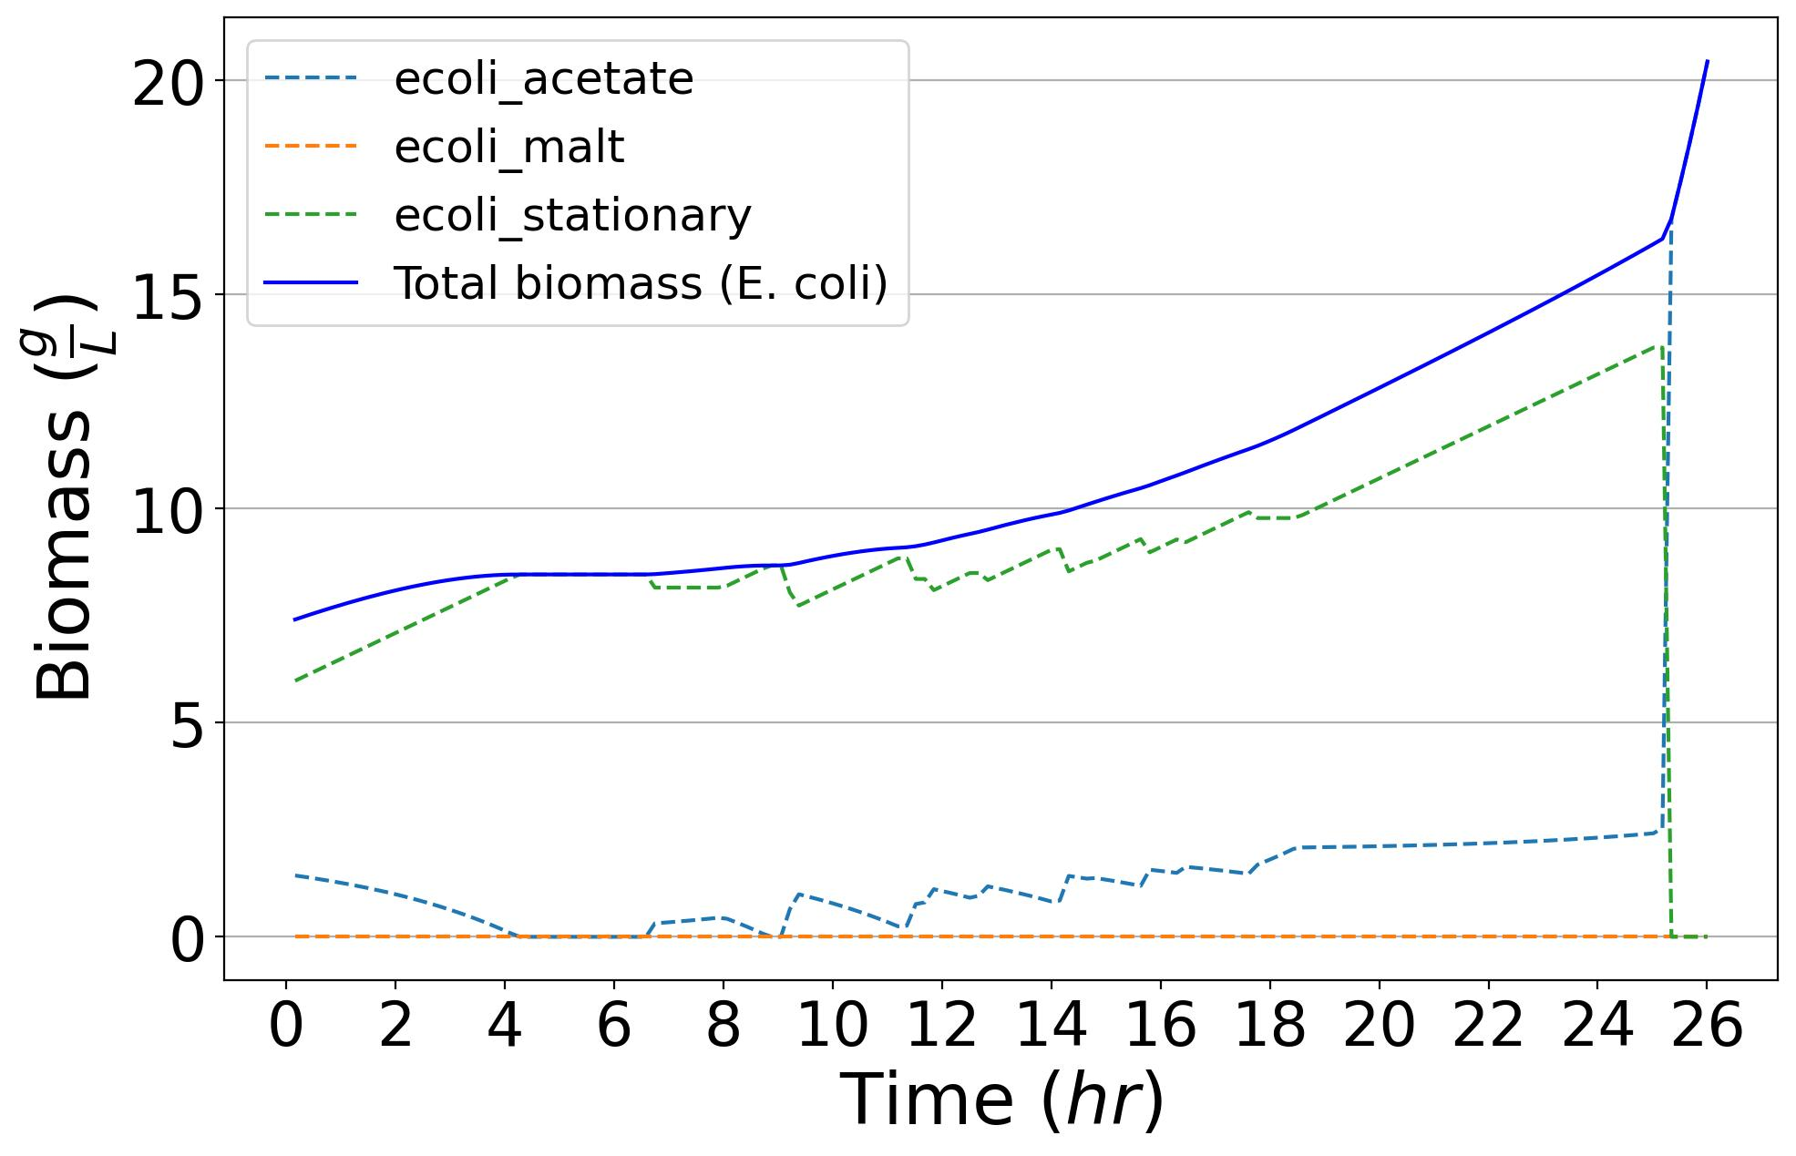
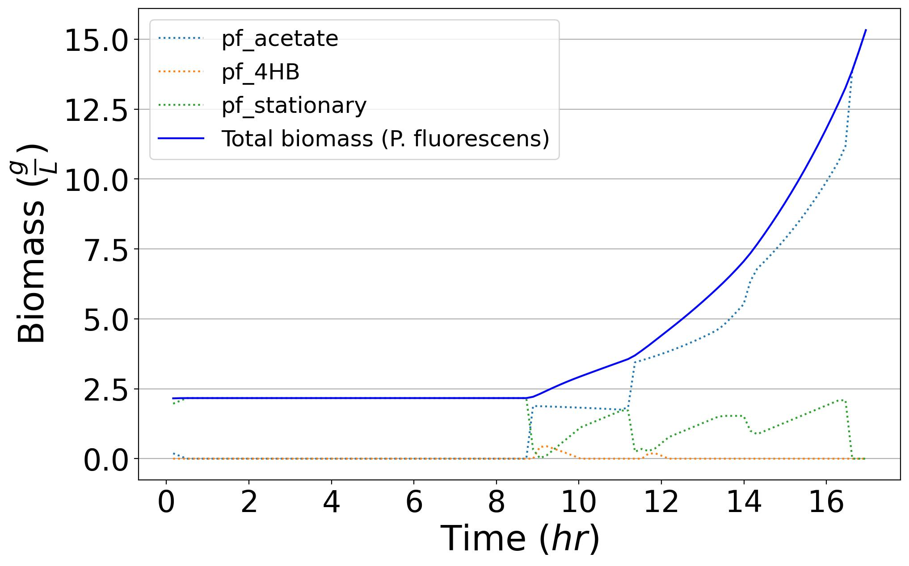
Coculture
30º plating
P. fluorescens
E. coli
D-Maltose
D-Maltose
+
4HB
Acetate

Slide 3
Coculture
30º plating
Coculture 37º plating
Coculture 12º plating
E. coli
P. fluorescens
D-Maltose
4HB
Acetate

Slide 4
Coculture
30o plating
Coculture 37o plating
Coculture 12o plating
E. coli
P. fluorescens
Maltose
4HB
Acetate

Slide 5
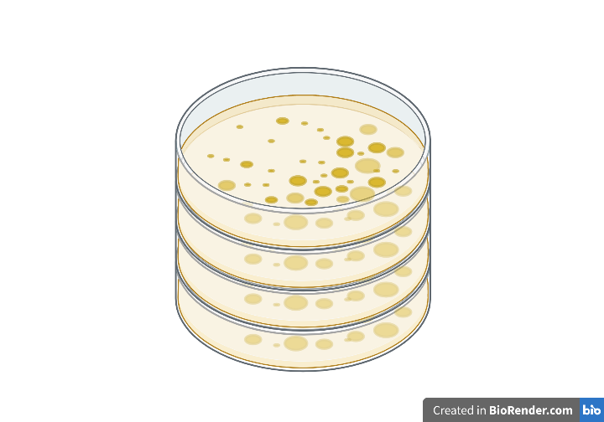
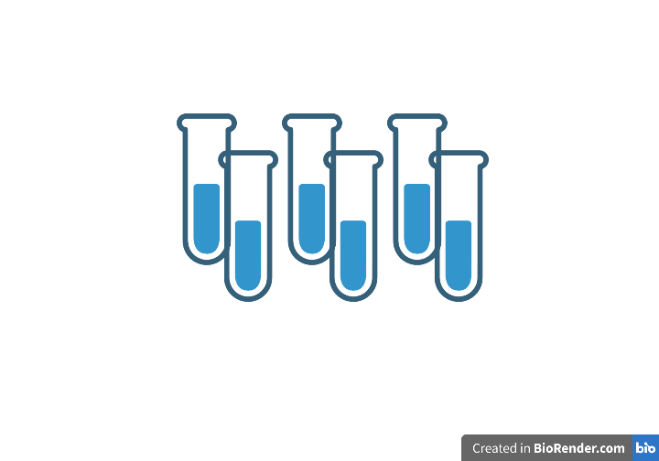
This figure has already been improved by AF
Maltose
4HB
Fluorescence- and plate- based methods
Acetate
37Cº
12Cº
E. coli
P. fluorescens
A two-member community consisting of P. Fluorescens and E. coli was chosen as an experimentally convenient system for several reasons. The genomes of each organism have been extensively studied. We developed two methods to accurately disentangle the composition of a liquid coculture. Finally, our research discovered significant unidirectional cross feeding from E. coli to P. fluorescens that led to interesting competitive dynamics depending on initial carbon source and organism ratio. These qualities led E. coli and P. fluorescens to be an excellent model to showcase our novel community model.

Slide 6
This figure has already been improved by AF
Replace names with actual chemical structures
Maltose
4HB
Fluorescence- and plate- based methods
37C˚
12C˚
E. coli
P. fluorescens
A two-member community consisting of P. Fluorescens and E. coli was chosen as an experimentally convenient system for several reasons. The genomes of each organism have been extensively studied. We developed two methods to accurately disentangle the composition of a liquid coculture. Finally, our research discovered significant unidirectional cross feeding from E. coli to P. fluorescens that led to interesting competitive dynamics depending on initial carbon source and organism ratio. These qualities led E. coli and P. fluorescens to be an excellent model to showcase our novel community model.

Slide 7
Metabolic modeling enabled research
Predict and rank (top 10 etc.) metabolites that are key to a microbial community’s metabolic interactions/composition
Discover new metabolic pathways/interactions by identifying molecules that should/should not be present within a community
Engineer community metabolism to exclude/include particular harmful/helpful organisms
Predict how certain stimuli (temperature, pH, toxins) may influence community composition by changing metabolite availability which in turn alters the web of metabolic interactions
CGSC methods - PoxB, AckA, Pta, and ACS knockout E. coli strains are derived from the BW25113 E. coli strain and were purchased from the Coli Genetic Stock Center (CGSC).
Thorough investigation of metabolic pathways requires multilayer omics analysis including metabolomics, proteomics, and transcriptomics. Previous omics analyses of diverse environments have produced a wealth of data on which to build models that predict organismal community dynamics from the molecular to phenotypic levels. These models allow researchers to judiciously direct limited resources towards metabolic hypotheses with the highest chance of success. One exciting component of holistic metabolic models is their ability to predict both the identities and quantities of metabolites produced and consumed by each organism. This information allows researchers to hone in on cross feeding metabolites that are produced at levels that sustain organismal growth. Models begin to identify key molecular species that enable symbiotic metabolic interactions between organisms within the vast sea of microbiomes. Moreover, metabolic models help identify metabolites that should be present, but are not, perhaps indicating previously unaccounted for metabolic cross feeding or inhibition is taking place within the microbial community.
E. coli and P. fluorescens were chosen for several reasons. Firstly they are model organisms that cover a wide range of disciplines including the human microbiome, bioproduction, synthetic biology, the rhizosphere, agriculture, and ecology. Secondly, the genomes and metabolic profiles of each organism have been studied extensively, enabling robust validation of metabolic models. Finally, these two organisms have never been studied as a coculture, leaving little opportunity for preconceived biases to guide model and hypothesis development.

